Slide 1
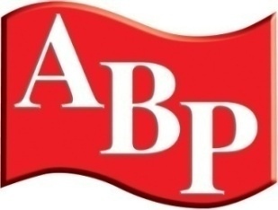

WELCOME
Ben Waller – ICDP

Slide 2

Factors for Success in a
Declining Market
Steve Young, Managing Director, ICDP
ABP Annual Convention
Birmingham, November 16, 2016
Notes:
ICDP
Project Office: Central Boulevard, Blythe Valley Business Park, Solihull, B90 8AG U.K.
Tel.: + 44 (0) 1564 711224 E-mail: projectoffice@icdp.net Web: www.icdp.net
Limited company registered in the UK, no. 6262484

Slide 3


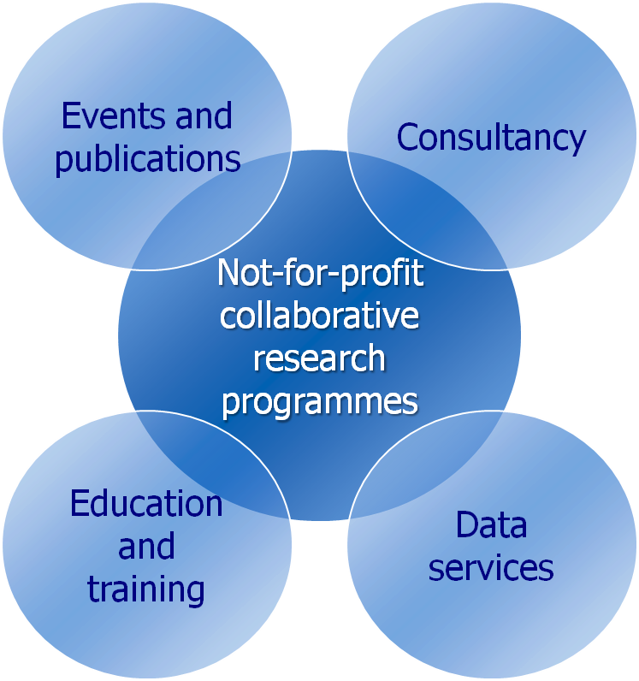




Who are ICDP?
Launched 2015
Pilot in 2017?
European, launched in China, now in discussions for Brazil
Research, consultancy, and other services
Research members from across the industry
European Members correct as of November2017
Notes:
First, a few words about ICDP.
We are a unique organisation, established as an industry funded research organisation almost 20 years ago, focussed only on looking for a better distribution model, given that the one we have today has been around largely unchanged for almost a hundred years.
Our roots are in Europe, but we are looking to establish an ICDP presence in the main growth markets, including China where our first research programme is under way, and we hope to launch in Brazil with a pilot study in the coming months.
Although research lies at the core of our business, we also offer consulting services, provide distribution data and are launching management education.
Our research programmes members are supported by most of the manufacturers, large importer and dealer groups, OE suppliers and their trade associations.
CHINA – 20% OF PARC HAS AN ACCIDENT EACH YEAR

Slide 4
Key points
UK market has improved, but long term trend still down
We suggest five areas to focus on for future success
But it could be worse…
Source: ICDP
Notes:
Three parts to the presentation, which is focussed on the European dealer environment:
External forces and industry economics mean that change is inevitable
We see three broad scenarios for the future, having discounted a fourth
Dealers should prepare for these challenges now, rather than wait and see until their OEM partners impose changes

Slide 5
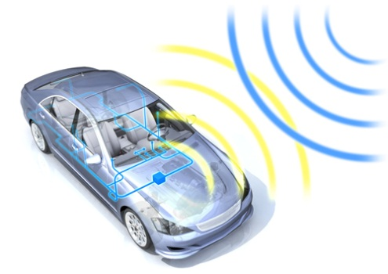
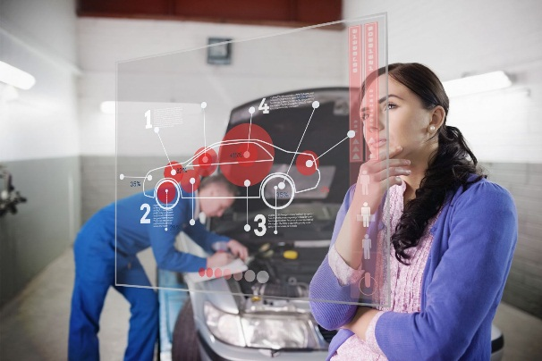
In the UK, there is a more balanced relationship than before
Optimised
repair costs
Repairers skills
Quality
Insurers
Agreements
Repair processes
Deals on parts
Telematics
IT
Balance flows
and profits
Maximise OE
parts sales
Body
Repairers
OEMs
Ability to
invest
Parts sales
Steer flows
to network
Source: ICDP
Notes:
4 YEARS AGO – DECLINE OF OUTLETS
MARGINS LOWEST IN EUROPE
INSURERS WERE DRIVING THE MARKET [AND CLAIM MANAGEMENT COMPANIES]
INSURERS STEERING ALL WORK
INSURERS:
OPTIMISED = CHEAP, QUALITY = LOW FOR CAR OWNERS
INSURERS WRITING TERMS THAT STEERED MOST CUSTOMERS
COMPETITION INVESTIGATION > LIMITED ABILITY OF INSURERS TO STEER WORK – especially for not at fault drivers
DIFFICULT TO SEE HOW MUCH IMPACT, BUT SEEMS MORE BALANCED NOW
BODY REPAIRERS – SAW INSURERS AS ‘WORK PROVIDERS’
DEALER GROUPS NOT THAT INTERESTED IN CRASH REPAIR, 10-15 DLRS PER BODYSHOP, BIG SCALE, MULTIBRAND
BUT INDEPENDENTS DOMINANT IN UK
OEMS – DEALERS NOT INTERESTED IN CRASH REPAIR, BUT ARE IN SUPPLYING PARTS
HEALTHY MARGINS
‘FACELIFT’ HELPS KEEP AHEAD ON PRICING AND GENUINE PARTS
TELEMATICS = CONNECTED CAR –
WHO RESPOINDS FIRST
GET IN FIRST, UNLIKELY TO MOVE THE CAR

Slide 6
Repairer numbers have stabilised, pricing improved
Source: Trendtracker, ABP and Audatex
Notes:
INDEXED – MEDIUM AND LARGE, INDEPENDENTS, DOMINATE MARKET CAPACITY, EVEN IF DOWN
DEALERS NOT INTERESTED
SMALL CRASH REPAIRERS STABILISED
LARGER BODYSHOPS BETTER ABLE TO INDUSTRIALISE PROCESS
AND BUY NEW TECH, SUCH AS NEW PAINT SOLUTIONS
VERY DIFFERENT TO SPAIN (SMALL IMT) AND FRANCE (SMALL FRANCHISED DEALER REPAIR SHOPS)

Slide 7
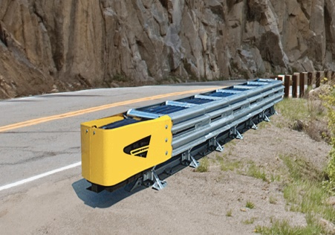
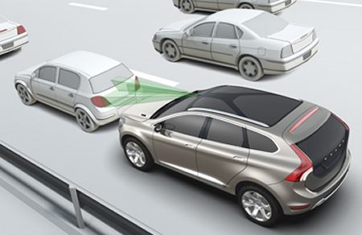
However, long term trend is still downwards
Insurers should brace themselves for a drop of up to 80 per cent in car insurance premiums as technology disrupts one of the mainstays of the industry, according to research from Boston Consulting Group and Morgan Stanley.
“The industry won’t feel the heat for the next five years or so but then things will accelerate,” he added, pointing out that some markets face an average decline of 4 per cent a year over the coming decades.
Financial Times, 01/10/2016
“Road travel could be as safe as rail or air, says Road Safety Foundation”
Fleet News, 15/11/2016
Absorption > Avoidance
Source: ICDP, Trend Tracker, Audatex, GIPA, ZKF; Boston Consulting Group. Morgan Stanley from Financial Times, October 1, 2016, Fleet News
Notes:
LOTS OF SOURCES, DATA NOT COMPARABLE, FRAUDULENT CLAIMS IN ITALY, KNOWN ISSUE
BUT ALL DECLINING
NB: The graph on this slide does not include the figures for glass repairs
AS FOR FUTURE….AUTONPOMUS CARS A WAY OFF
BUT, STEPPING STONES TO GET THEERE VIA SHIFT FROM FOCUS ON IMPACT ABSOROPTION, TO EVER MORE FOCUS ON AVOIDANCE
LOTS OF FACTORS AT PLAY….
ABS HAS HAD AN IMPACT ON ACCIDENTS
SMALL ACCIDENTS CAN NOW BE HIGH COST - £600 FOR BUMPER RADAR
INSURERS SEE PREMIUMS DECLINE, PROBLEM FOR THEM, CASH FLOW IS HOW THEY MAKE THEIR MONEY
VOLVO PLEDGE – NO CUSTOMER WILL DIE IN THEIR CAR BY 2020- SAFER ROAD TRAVEL WILL LIKELY ALSO BE A PRIORITY FOR GOVERNMENTS
MOST SEE FEWER ACCIDENMTS AND LESS SEVERE ACCIDENTS – MAY MEAN MORE MINOR REPAIR AS WELL AS FEWER SERIOUS IMPACTS – MORE COMPLEX REPAIRS?

Slide 8
We see five factors for success in this market
Gear towards retail work
Find a niche, go big or go home
Find new talent and nurture it
Be prepared to work with different players
Manage economic write-offs more effectively
Source: ICDP
Notes:
5 FACTORS FOR SUCCESS IN A DECLINING MARKET

Slide 9
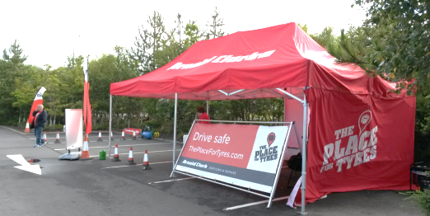
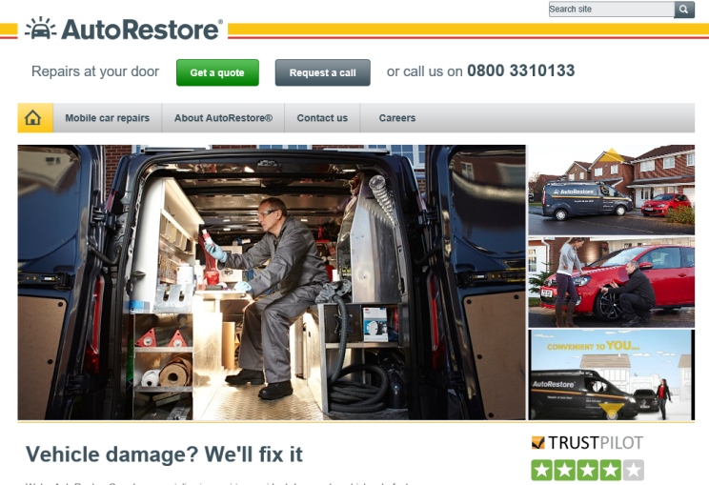
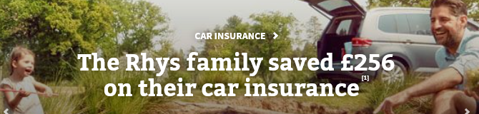
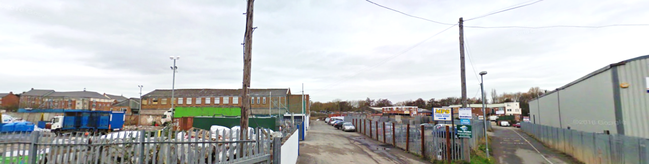
Gear towards retail work
Higher excesses driven by price comparison websites…
Some repairers moving to cover higher margin retail work, via connecting with the customer….
Previously rising premiums tamed by price comparison websites…
… via increased average excess (now around £350-£500)
Mobile repair proving a challenge…
Dealer groups need more work…
…and as a result, customer paid jobs are increasing
…but many repairers perhaps less customer-facing today than they were in the past…
More SMART and cosmetic repairs
Insurance only covers approximately 90% of the cost in the UK
“Bodyshops have geared themselves for insurance work, and many no longer advertise their business”
Source: ICDP; expert interviews, Google
Notes:
“Prior to price comparison website, premiums were increasing quickly”
“Customers now taking out policies with a greater excess (350-500 average)”
“In 2008, a quarter of car insurance policies had an excess of more than £75 for replacing the windscreen. Now almost half do”† BBC 2011
“Insurance covers approximately 90% of the cost of crash repair in the UK, 10% paid by customer”
DECENT MARGINS IF YOU CAN REACH THE CUSTOMER
AUTYORESTORE – WAS MOBILE, THEN OPENED PHYSICAL OUTLETS, THEN BACK TO MOBILKE ONLY – CLEARLY MAKING THIS WORK HAS BEEN A CHALLENGE, - CAN YOU REALSITICALLY DO MORE THAN ONE JOB IN A DAY?
DEALER GROUPS NEED MORE WORK TO RESPOND TO DECLINING AFETRMARKET – E.G ARNOLD CLARKE – ADDING TO THEIR RETAIL OFFER, CATEGORY RETENTION [E.G. TYRES] AND CUSTOMER CONTACT AND RETENTION IN GENERAL
MANY REPAIRERS BECOME INVISIBLE TO RETAIL CUSTOMERS, IN INDUSTRIAL ESTATES WITH LITTLE ADVERTISING…

Slide 10
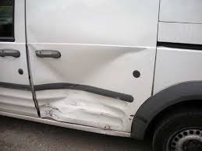
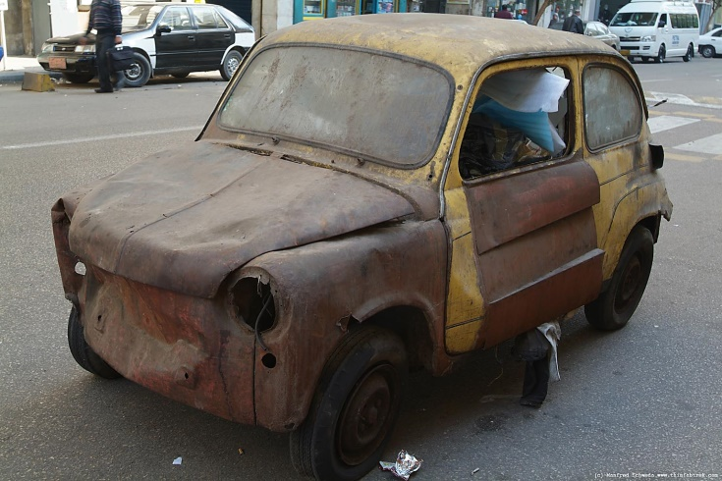
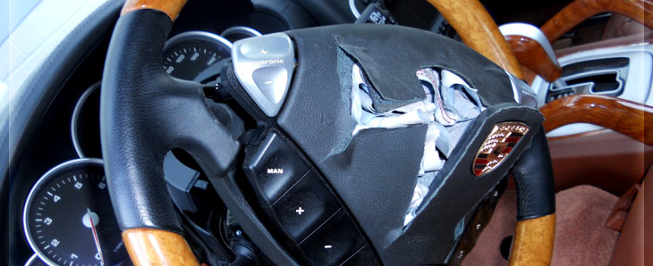
Find a niche, go big or go home
Alongside decline in volume, rising costs have not all been passed on…
Lack of profitability is a barrier to investment…
And if you can’t be big, be different…for example…
“Bodyshops work on such small margins, typically 1-2% net profit resulting in at most £20 profit for a bodyshop on a £1000 repair”
Overnight LCV?
Although economies of scale can make a difference
Older cars
“A standalone bodyshop must be at least 2000 square metres to be able to be profitable.”
E.g. insurer chains select work….
Technical areas such as airbags
Complex work contracted out
Complex work contracted out
Paint cost up 90% in 10 years, but benefits via improved technology
Simple work segmented
Source: ICDP
Notes:
LARGER BODYSHOPS NEED TO EB ABLE TO AFFORD INVESTMENT IN NEW EQUIPMENT TO ALLOW INDUSTRIALISED PROCESSES
E.G. PAINT
COSTS OF PAINT GONE UP, BUT…
IF NEW TECHNOLOGY MEANS FASTER KEY TO KEY PROCES TIME, THEN TIME SAVINGS MAKE SENSE
£80K ALUMINIUM BODYSHOP – HOW IS THAT GOING TO PAY BACK IN A REASONABLE TIME PERIOD?
RUNNER REPEATER STRANGER – RUNNERS CAN BE SEPARATED, LARGE INSURER OWNED WORKSHOPS TEND TO KEEP THESE JOBS AS FLOW WORK – LARGELY KNOWN, - BUMPERS, FRONT WIONG, HEADLIGHTS ETC
REPEATERS – MESSY JOBS ARE CONTRACETD OUT
E.G. SET UP WHEN AVIVA WAS NORWICH INSURANCE - SET UP FLOW LINES

Slide 11
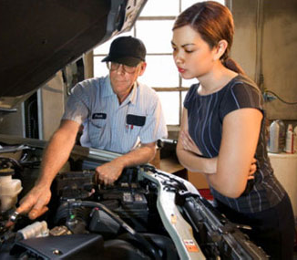
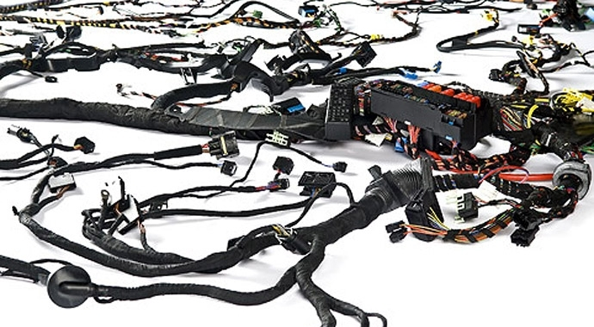

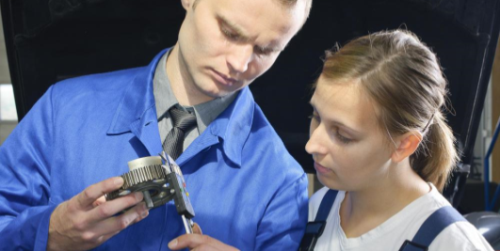
Find new talent and nurture it
Whether workshops are larger or more specialist, training will be required
The sector needs to attract more technicians
Succession planning of management and ownership is a challenge
Larger and more industrialised processes
More complex, technological skills required
Deep knowledge for niche solutions
Acute skills shortage, especially painters
Charity Autoraise supports apprenticeships to help attract young people into the business
Thin margins mean that the sector is not a target investment
Owners and managers need to be passionate about the sector
Source: ICDP
Notes:
CHARITY AUTORAISE – THEER IS A PROBLEM WITH THE MARKET IF APPRENTICES ARE NOT SUPPORTED BY PAYMENT FROM INSURERS…
The skills shortage is so acute that a charity called Autoraise has been established by people from within the sector to establish and support apprenticeships that will help attract young people into the business. As things stand there is a critical shortage of all the key skills around body repair....especially painters.
So called Quick Repairers are also encroaching on the business of full-scale bodyshops. The scale of work now possible in some of these operations, using modern techniques and equipment....including infra red drying, etc., means that many are attracting bread & butter work away from the full scale operations. This is exacerbated by high insurance excess charges, which mean that fairly large scale repairs are now possible within the excess limit. The extended capability and convenience of the Quick Repair operations is enabling them to corner a lot of this work.....
I know that Sytner, as an example, have a number of well invested Quick Repair facilities that make really good money. They also have a number of full repair facilities across the group which have the scale required for profitability, but have a much lower return on investment than the Quick Repair facilities do.....
[In a normal market, shortage of capacity would mean that prices rise, but in this market, profitability is squeezed and keep labour charges very low – dysfunctional market, but always someone willing to offer a crazy price…?]

Slide 12
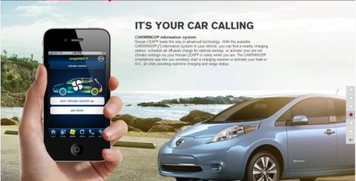
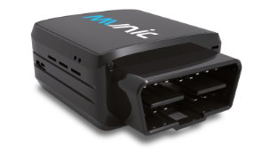
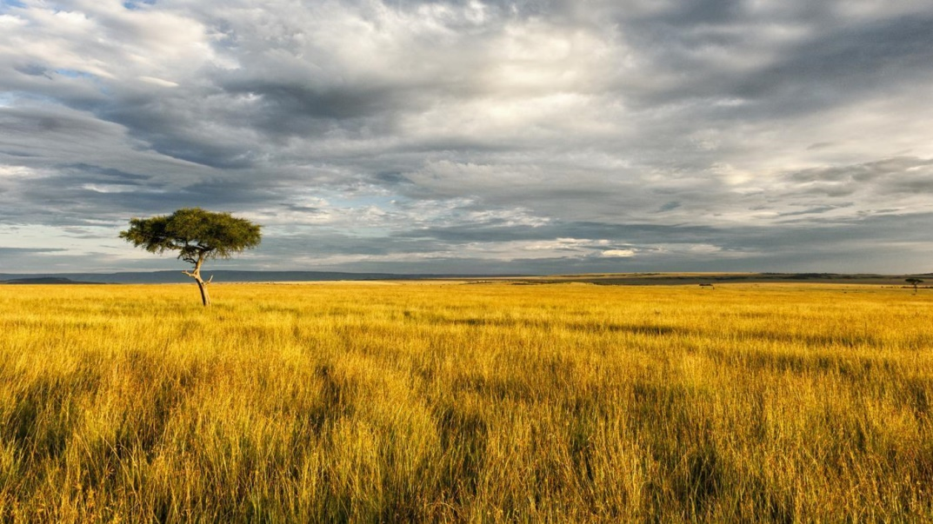
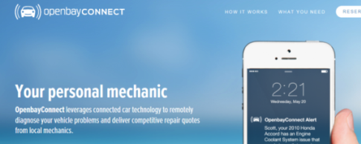
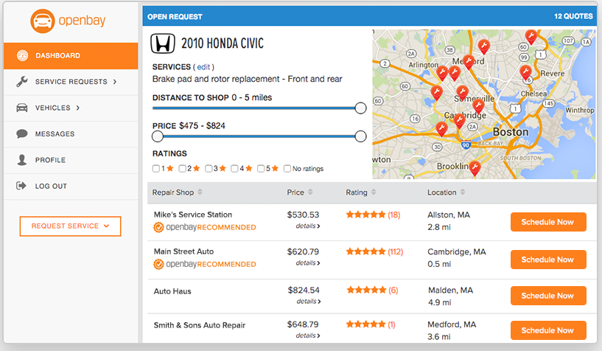
Be prepared to work with different players
New and aftermarket connected car platforms may transform access to the market
But will connected car mean that repairers can actively ‘go hunting’ for new work?
The aim should be to get to the customer before the insurer does - or anyone else
Who responds first, automatically or otherwise?
Could OEMs or another third party become a trusted intermediary for customers, between insurers and repairers?
Connected car may not be able to help report all damage, but may help link more customers to more providers via ‘all-purpose’ offer platforms
However, customers will need to be incentivised to share data - e.g. our research found that around half of customers would be prepared to use telematics to cut their insurance premiums†
Source: ICDP, † 2014, sample 1050 customers (EU markets, incl UK), Nissan, OpenBay
Notes:
Repairers will have to bid for the work, as opposed to their current attitude of looking to “work providers” – their way of referring to insurance companies. Reminds me a bit of zoo animlas – no longer hunting, just waiting for the keepr to feed them. Will the connected car change this?
VW LCV – German VW dealer network offering retrofit aftermarket devices
EVEN IF APP CANNOT PICK UP MINOR DAMAGE, AN OPEN PLATFORM WITH LOTS OF APPLICATIONS – LIKE OPENBAY – MAY BE FIRST PORT OF CALL FOR CUSTOMER
IF SO, JUST BEING IN THE VIRTUAL OPEN CUSTOMER MARKETPLACE MAKES YOU VISIBLE AND ABLE TO GO AND ‘HUNT’ FOR CUSTOMERS
WILL REPAIRERS HAVE TO BECOME BETTER AT DIAGNOSIS OF CONNECTED CAR DAAT – FOR ALL SORTS OF REASONS…

Slide 13

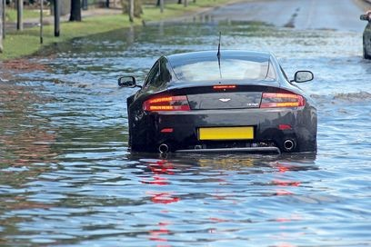
Manage economic write-offs more effectively
Focus on better valuation processes
Don’t let the write-offs disappear into a black hole
Communicate to the market
Warn customers of risks of buying cars repaired by the cowboys!
For a small professional workshop, write-off repair can be good work!
Reassure customers that a properly repaired write-off can be a great solution
Source: ICDP, †ABP in collaboration with Audatex
Notes:
WRITE OFF CLEARLY AN ISSUE FOR MANY CUSTOMERS – 5 YEAR OLD PASSAT AND AIRBAGS DEPOLYED CAN BE A WRITE OFF
CUSTOMERS CAN LEIGITANELY RESCUE THEIR CAR!!
SMALLER WORKSHOPS – IN DOWNTIME – PROJECTS TO TURN A WRITE OFF INTO LEGIT CAR
DON’T LET COWBOTS GET THE WRITE-OFFS
COMMUNICATE TO THE MARKET – ABP MEMBERS CAN WARN CUSTOMERS OF THE RISKS – AND THE BENEFITS

Slide 14


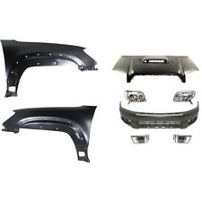
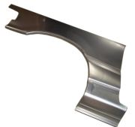
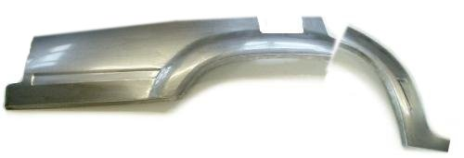
But it could be worse…
In France, legislation is about to come into force mandating the offer of used and recycled parts
French regulation effective 01/01/17
  Obliges repairer, including body repairer, to offer used parts – salvaged or remanufactured
    Currently only 4% of the market
    Only drivetrain, steering, brakes and suspension exempt
    Risk of fines - €3k to 15k
  Principle accepted by repairer associations, but details of application remain unclear (parts identification, sourcing…)
  Consumer associations have raised the question around ‘steering’ of customers
  Creates uncertainty - parts may add labour time, and supply not robust so poor availability
Not obvious what the impact will be - lots of issues still unresolved, and we will see what happens!
Source: ICDP
Notes:
For example, in France, a current hot topic is a local regulation which will oblige – from 01/01/17 – any car repairer (and especially body repairers) to propose used parts to repair their cars. The details of how this will be set in practice are not clear (parts identification, sourcing…), and a lot of repairers are concerned about this. There are also some legal cases dealing with the balance of power between repairers and insurance companies (‘agreement’ processes, ability to steer customer flows to preferred partners…).
Used part is half the price…
Types of parts - Re-used parts / salvage /Remanufactured
Body/ trim/ glazing / lighting/ Mechanical and electronics
Exceptions Drive train, steering / braking / suspension
Implementation Repairers will be fined if they don’t comply
3,000 to 15,000€
Exception rules: Jobs made under warranty, recall campaigns
Parts presenting a risk for the car safety, the environment
Unacceptable leadtime
Consequences & reactions
Now accepted by the different repairer associations, fter various amendments
Conditions of application not clear yet - E.g. are repairers just obliged to inform customers, or should they make a quote?

Slide 15
If there’s one message, go find new retail customers
UK market has improved, but long term trend still down
UK sector has recovered from challenges it faced a few years ago, but needs to re-establish itself and be in control of their own businesses
We suggest five areas to focus on for future success
But it could be worse…
Source: ICDP
Notes:
Always be a low margin, mature business – insurers and valuation are on top of this
Need to focus on process, reduce time and improve cash flow
Anything that makes life easier for insurer – and end customer – is good news
PLAYERS LIKE LKQ LOOKING TO DIRECT PARTS – REFERENCING AGREED LKQ PRICING, BUNDLED PARTS – AIMING TO INCREASE SHARE OF NON-OEM PARTS, [EVEN IF REPAIRERS DON’T LIKE THESE WITH LOWER MARGINS, ONLY MARGIN ON THE LABOUR]
Cost focus – e.g. repair kits for headlamps after front impacts
Declining market,
Cannot be passive,
Keep up with technology

Slide 16

Central Boulevard,
Blythe Valley Business Park,
Solihull B90 8AG, UK
E-mail: projectoffice@icdp.net
Limited company registered in the UK, no. 2860398
The Squaire West 12,
Am Flughafen,
60549 Frankfurt am Main, Germany
E-mail: icdpgermany@icdp.net
GmbH registered in Frankfurt am Main
Web: www.icdp.net
All requests to reproduce this material should be directed to the addresses above

Slide 17
THANK YOU
Ben Waller – ICDP

